Slide 1
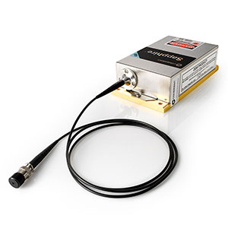
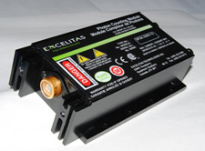
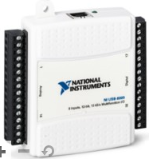
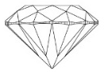


NV lab setup diagram
SRS SG384
Signal generator
MW switch
Green laser
Coherent Sapphire 532
Lens
AOM
MW amplifier
Mirror
I
Q
TTL
+5V
-5V
Fiber Coupler
Digilent Analog Discovery2
DO
0
1
2
3
4
V+
V-
AWG Keysight
33622A
Excitation
Fiber Launch
Swabian Time Tagger
PC
1
2
3
4
APD
Camera
Beam splitter
Photodiode
Manual translation stage
NI USB-6008
ao0
Dichroic
Objective
Sample
Nanopositioning system controller
Collection
Fiber Launch
ao1
Z
X
Y
MW terminator
PCB
Nanopositioning system
NI USB-6008
532 nm notch filter &
633 nm long pass filter
ao0
Magnet
ao1

Slide 2
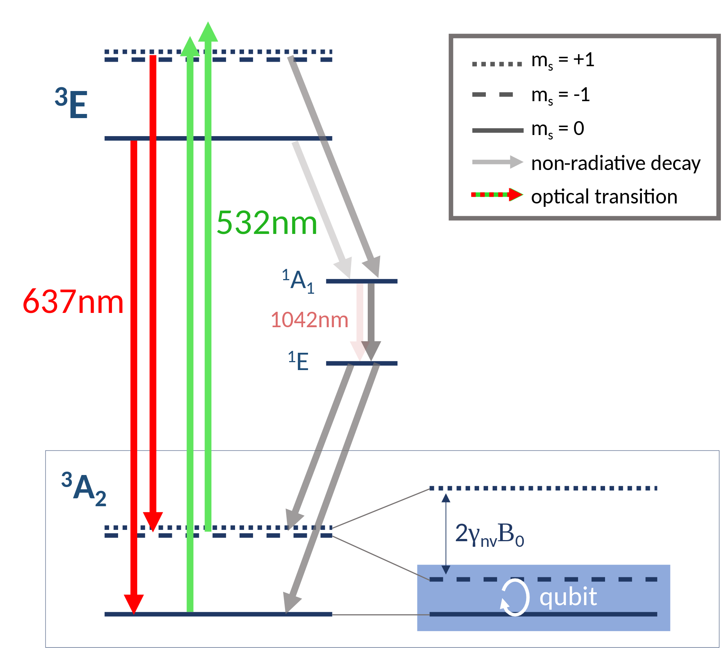
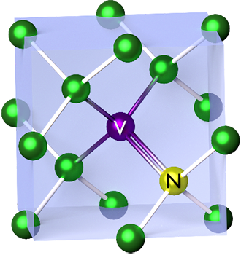
Nitrogen Vacancy Center
Nitrogen Vacancy (NV) center in the diamond lattice
NV spin dynamics
Picture source: https://en.wikipedia.org/wiki/Nitrogen-vacancy_center

Slide 3
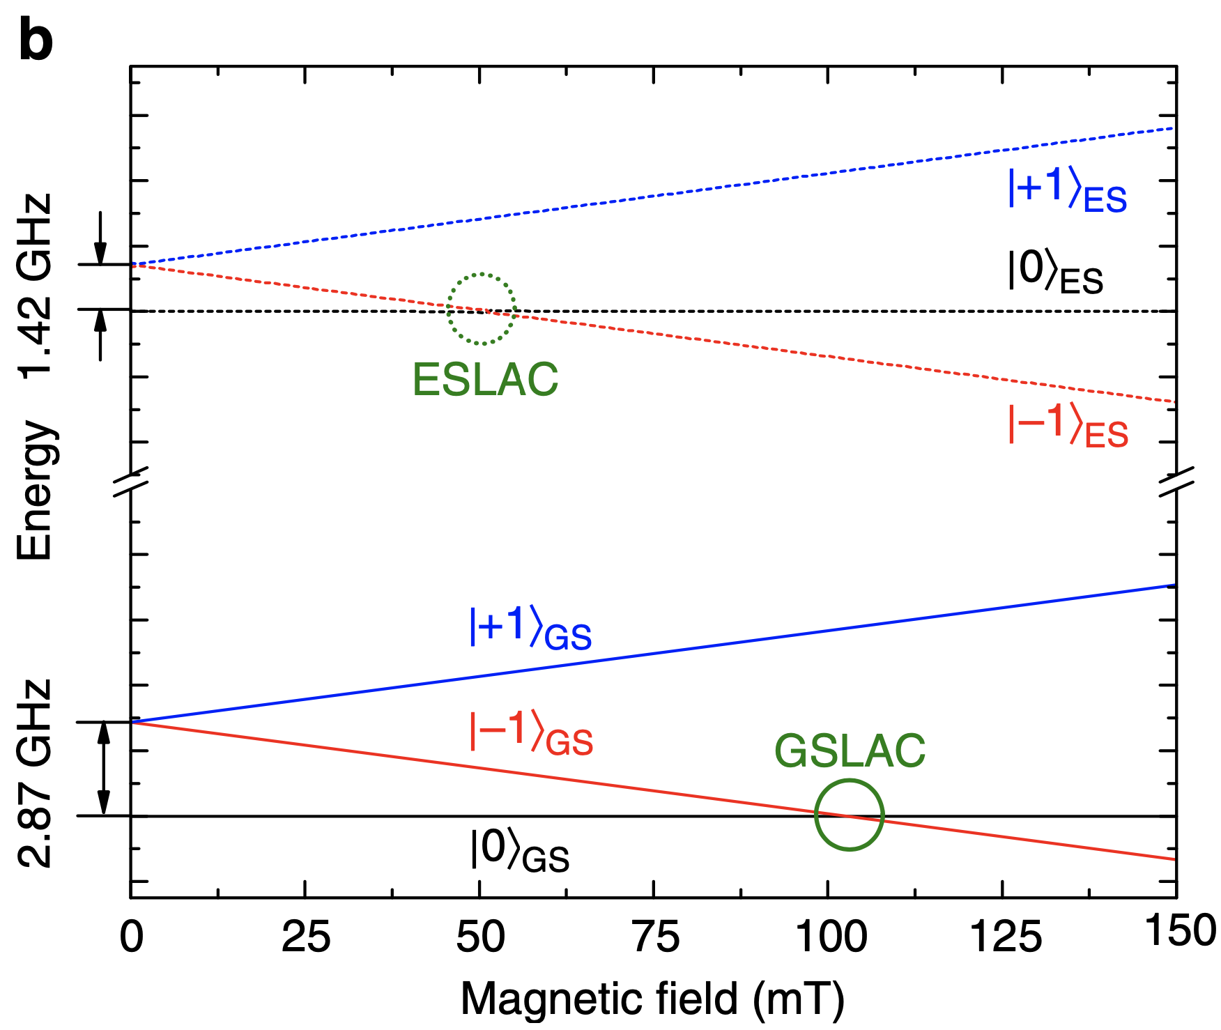
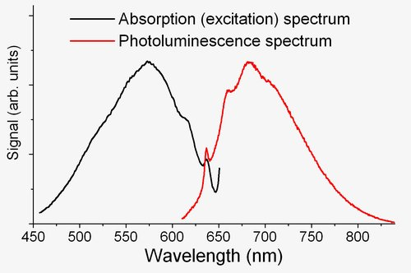
NV center properties
NV absorption and photoluminescence spectra
Zeeman effect under external magnetic field
Picture source: https://en.wikipedia.org/wiki/Nitrogen-vacancy_center
Nature communications 4.1 (2013): 1-7.

Slide 4
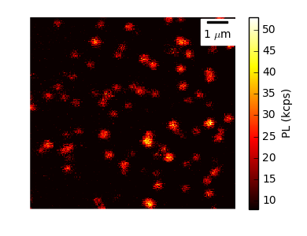
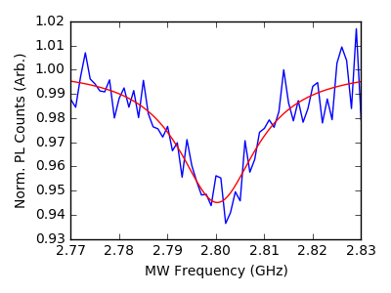
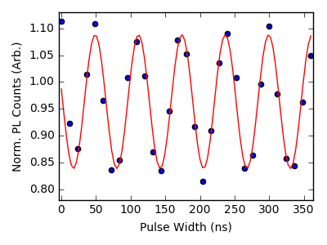

Lab mission
Run confocal scans to find your NV center.
Optically detected magnetic resonance (ODMR) experiment to find NV transition frequencies.
Rabi measurement to calibrate $π$ and $π/2$ pulses.
Characterize your NV qubit coherence time.
Confocal image
ODMR
Rabi

